Slide 1
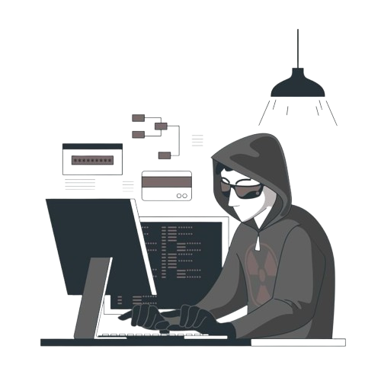



Raghav Dixit
Phising Awareness Training
26 september , 2025
code alpha

Slide 2

Raghav Dixit
What is Phising in
Cybersecurity?
Cyberattack tricking users to reveal sensitive data.
These attacks are usually carried out through emails, fake websites, SMS (smishing), or phone calls (vishing) that look legitimate but are actually malicious.
Phishing relies on social engineering, exploiting human trust rather than hacking systems directly. The goal is to deceive users into taking an action — like clicking on a malicious link, downloading an attachment, or entering credentials into a fake login page — that benefits the attacker.
Phishing is a type of cyberattack in which attackers impersonate trusted organizations, websites, or individuals to trick victims into revealing sensitive information such as usernames, passwords, credit card details, or financial data.

Slide 3
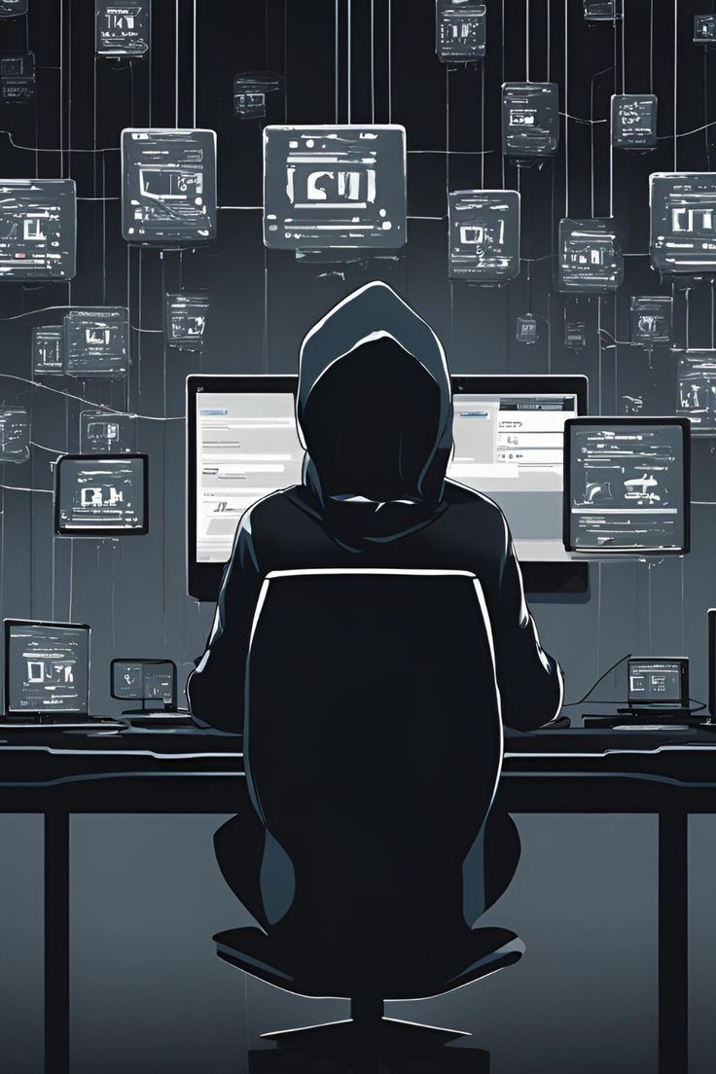
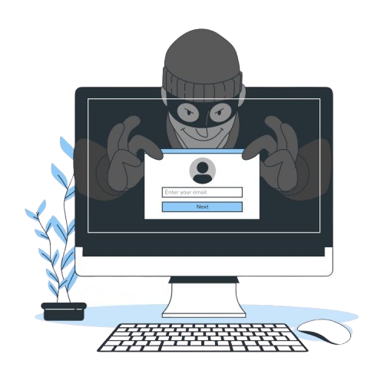
Raghav Dixit
"Phishing matters because it threatens your privacy, money, and online security."
Phishing attacks can steal sensitive information like passwords, banking details, and personal data.
They are a leading cause of identity theft and financial fraud.
For companies, phishing can cause data breaches, legal issues, and reputational damage.
Learning to recognize phishing attempts is crucial for staying safe online.
Why Phising Awareness Matters?
Staying ahead in a dynamic threat landscape

Slide 4


Raghav Dixit.
TYPES OF
PHISING
Strengthening defenses through awareness
"Phishing comes in many forms, each using a different trick to deceive users."
Email Phishing
Spear Phishing
Smishing
Learns and adapts to emerging cyber threats
Vishing
Improves incident response times and decision-making
fake emails that look like they’re from trusted companies
A highly targeted attack aimed at specific individuals or organizations
Phishing via SMS or text messages, often containing malicious links
Voice phishing done over phone calls, where attackers pretend to be banks or officials.

Slide 5
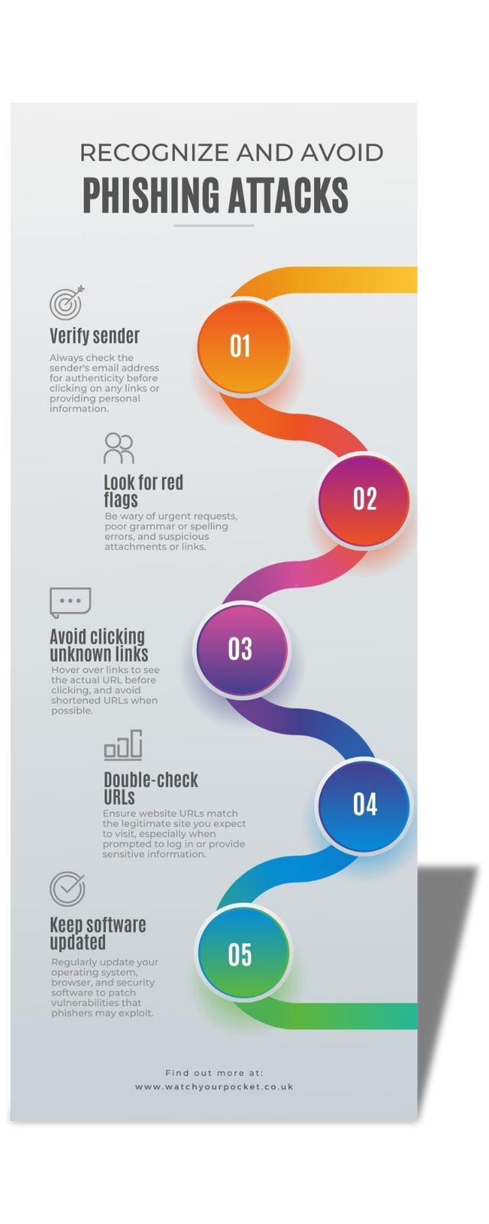

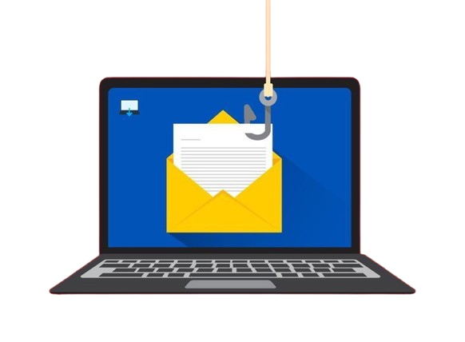
Raghav Dixit
Recognize a Phising Email
Intelligent solutions for complex problems
Take a look at the image and simple follow all the steps explained in there to remain safe from online scams

Slide 6
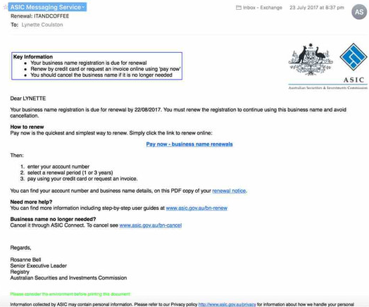
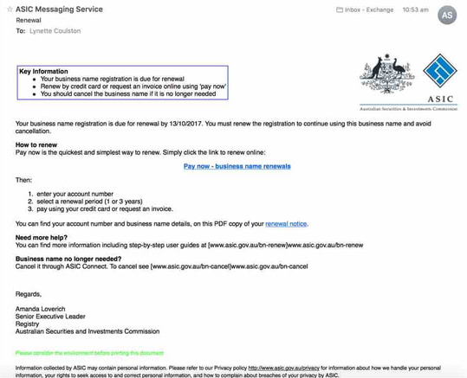
REAL
FAKE
Analysis Of Fake Email
REAL WORLD
EXAMPLE
I first checked the sender’s email and saw it wasn’t from ASIC — it came from asic.transaction.no-reply@asicsaustralia.biz, a fake domain. The email also didn’t mention my name or business, which was suspicious. Finally, I previewed the link and found it led to eoacik.com, not the real ASIC website. These signs confirmed it was a phishing attempt.
Raghav Dixit

Slide 7


Raghav Dixit
Don’t click on unknown links
BEST PRACTICES
Verify sender address & URL
The Double Check is Necessary. . .
Enable 2FA (Two-Factor Authentication)
To stay safe from phishing, always double-check the sender’s email address and hover over links before clicking. Avoid downloading unexpected attachments and be cautious of emails with urgent or threatening language. Enable two-factor authentication (2FA) wherever possible, keep your software and antivirus updated, and report suspicious emails to your organization or email provider.
Keep software and antivirus updated
Report phishing attempts

Slide 8
QUESTION 1
Email link says yourbank.com but URL is different. This is called…
Safe redirect
B
Spoofed link
C
Newsletter link
A

Slide 9
QUESTION 2
Email asks to update personal info immediately. This tactic is…
Urgency trick
B
Normal procedure
Newsletter update
A
C

Slide 10
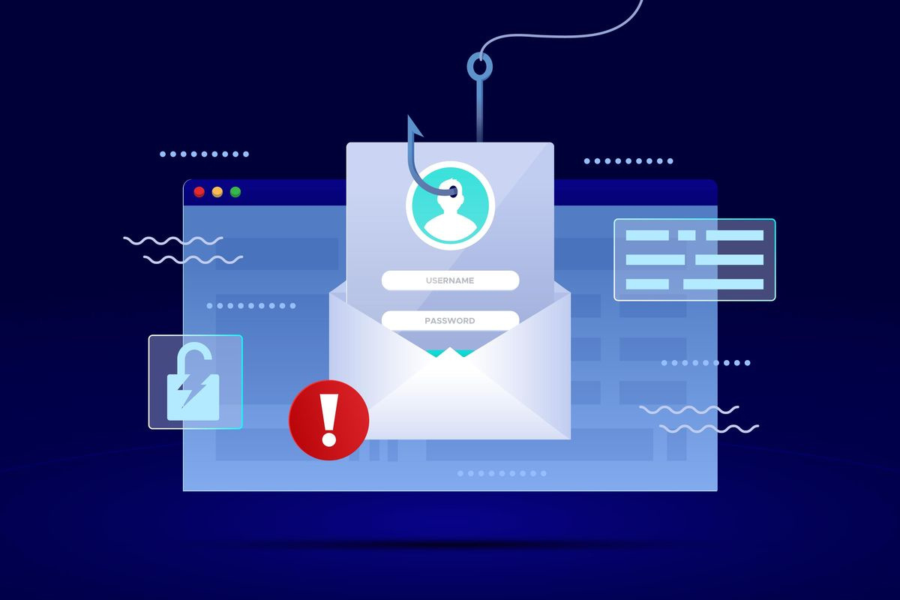


Raghav Dixit
ANSWERS
Q1:- B.) SPOOFED LINK
Q2:- A.) URGENCY TRICK
https://www.linkedin.com/in/raghav-04-dixit/
Thank You
raghavone24@gmail.com

